Slide 1
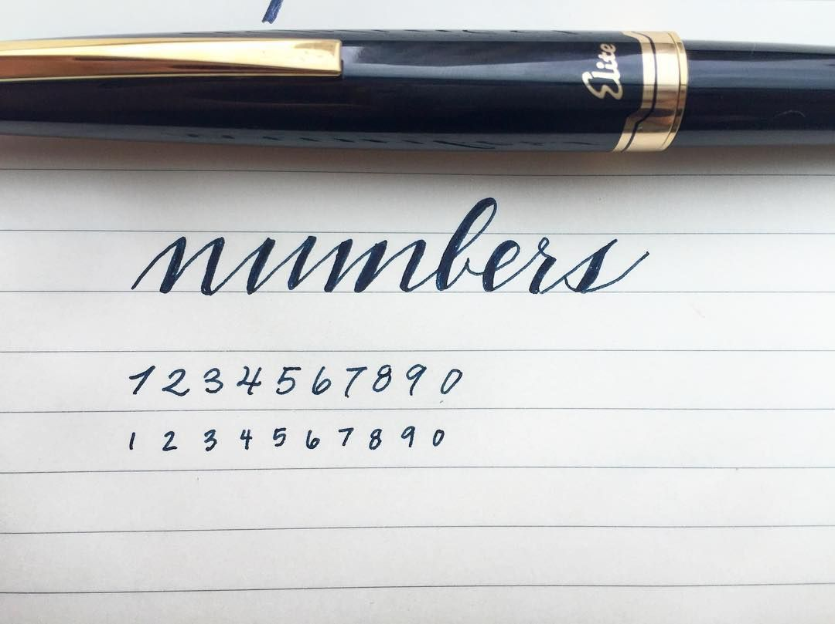
Digit Recognition
Using CNN Model to Identify Handwritten Digits
Group Member:
Shuwei Deng
Mengqi Li
Yuxuan Liu
Jiwei Zeng

Slide 2
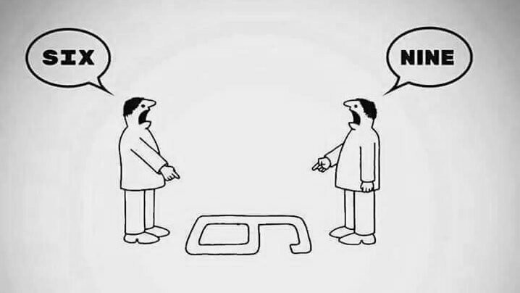

Agenda
Home Page
01
02
03
04
Introduction of the problem and reasons of interest
Data Preparation and Modeling
Model Evaluation
Conclusion and Application

Slide 3
Home Page
Intro
What is Handwritten digit Recognition?
And why we are interested
duction
Handwriting recognition is the ability of a computer to receive and interpret intelligible handwritten input from sources such as paper documents, photographs, touch-screens and other devices.
We are curious about what can we analyze using images. Having these images, can we train a model that is able to automatically recognize the information in the images?

Slide 4
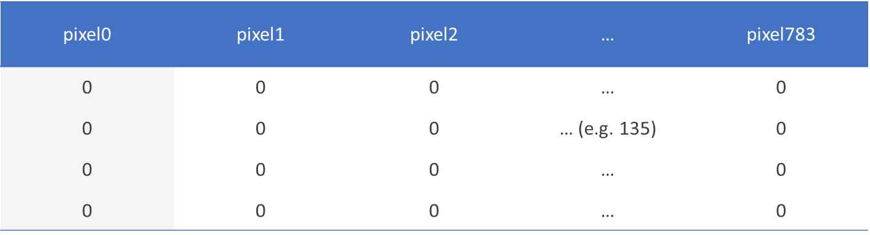

Data
Data Collection
DATA
The Kaggle MNIST Handwritten Digit Recognition Train Dataset
.
The training set contains 42,000 rows of number inputs from 0 to 9 and 785 column including the “label” column with no null values. Each image includes 784 pixels in total (28 in height and 28 in width). Each pixel associated with a pixel-value from 0 to 255 indicates the darkness of the pixel, the higher the value, the darker the pixel.

Slide 5
Transition
Model Selection
Convolutional Neural Network
Option A(CNN)
Performance depends on many factors including high accuracy, low running time, and low memory requirements.
Option B (Simple NNs)
Option C(SVM)
In SVMs, we typically need to do a fair amount of parameter tuning, and in addition to that, the computational cost grows linearly with the number of classes as well..
Architectures have to be fine-tuned to achieve the best performance. Few layers lose the accuracy.
Final Model

Slide 6
Data Preprocessing
Data
Normalize
Reshape
This process makes convergence faster while training the network.
Reshape the each row of the data to 3D
One-Hot Encoding
Splitting
Convert categorical variables
We split train and validation set with proportions of 90% and 10%.

Slide 7
Data Preprocessing
Data
Normalize
Reshape
This process makes convergence faster while training the network.
Reshape the each row of the data to 3D
One-Hot Encoding
Splitting
Convert categorical variables
We split train and validation set with proportions of 90% and 10%.

Slide 8
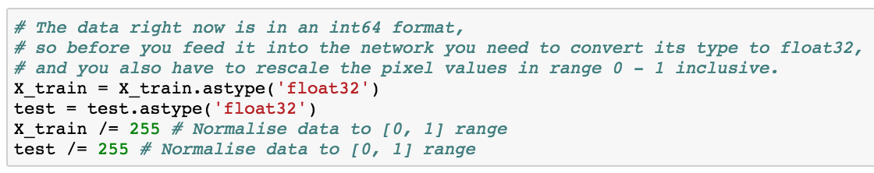
Data Preprocessing
Normalize Data
Normalize
Normalize
The pixel-values ranging from 0 to 255. The values have too many variables for the learning algorithm to process, so we make the input parameter have smaller data distribution into a scale of 0 to 1. Moreover, because the inputs are images, the pixel values cannot be negative.
This process makes convergence faster while training the network.

Slide 9
Data Preprocessing
Data
Normalize
Reshape
This process makes convergence faster while training the network.
Reshape the each row of the data to 3D
One-Hot Encoding
Splitting
Convert categorical variables
We split train and validation set with proportions of 90% and 10%.

Slide 10
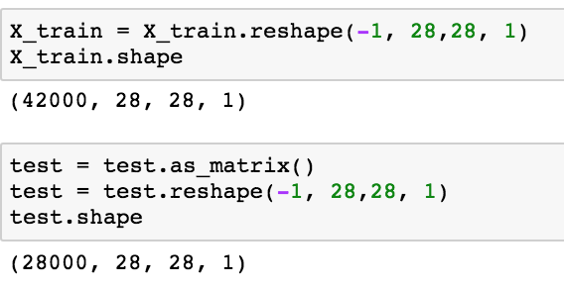
Data Preprocessing
Reshape Data
Reshape
Reshape the each row of the data to 3D
Reshape
At first, pandas stock our train and test images in 1D (1*784), we reshaped data to 3D (28*28*1) matrices, since keras wants an extra dimension in the end. If the data is RGB images, it would have been 3 channels (28*28*3). In this case, the dataset is gray scale image so it only uses one.
.

Slide 11
Data Preprocessing
Data
Normalize
Reshape
This process makes convergence faster while training the network.
Reshape the each row of the data to 3D
One-Hot Encoding
Splitting
Convert categorical variables
We split train and validation set with proportions of 90% and 10%.

Slide 12
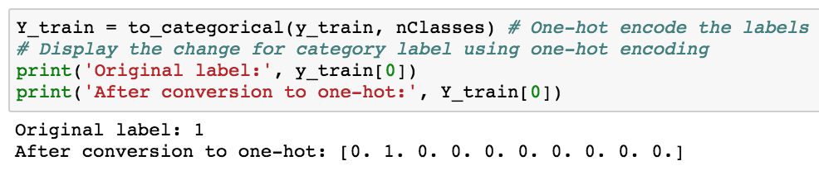
Data Preprocessing
Data
One hot encoding
One-Hot Encoding
One hot encoding is a process that converts categorical variables that most machine learning algorithms do not understand into a binary form. Labels are 10 digits numbers from 0 to 9. In order to make the algorithm easier for the computers to process, we did one-hot encoding to “binarize” the labels.
.
Convert categorical variables

Slide 13
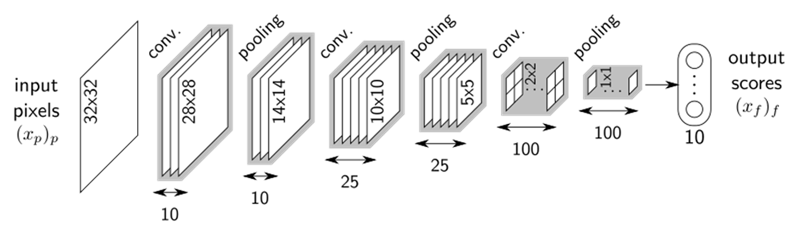
Model Explanation
Model Page
CNN Model Architecture
In → Conv2D→ LeakyRelu→ [ Conv2D→ LeakyRelu → MaxPool2D → Dropout]*3 → Flatten → Dense → Dropout → Out

Slide 14
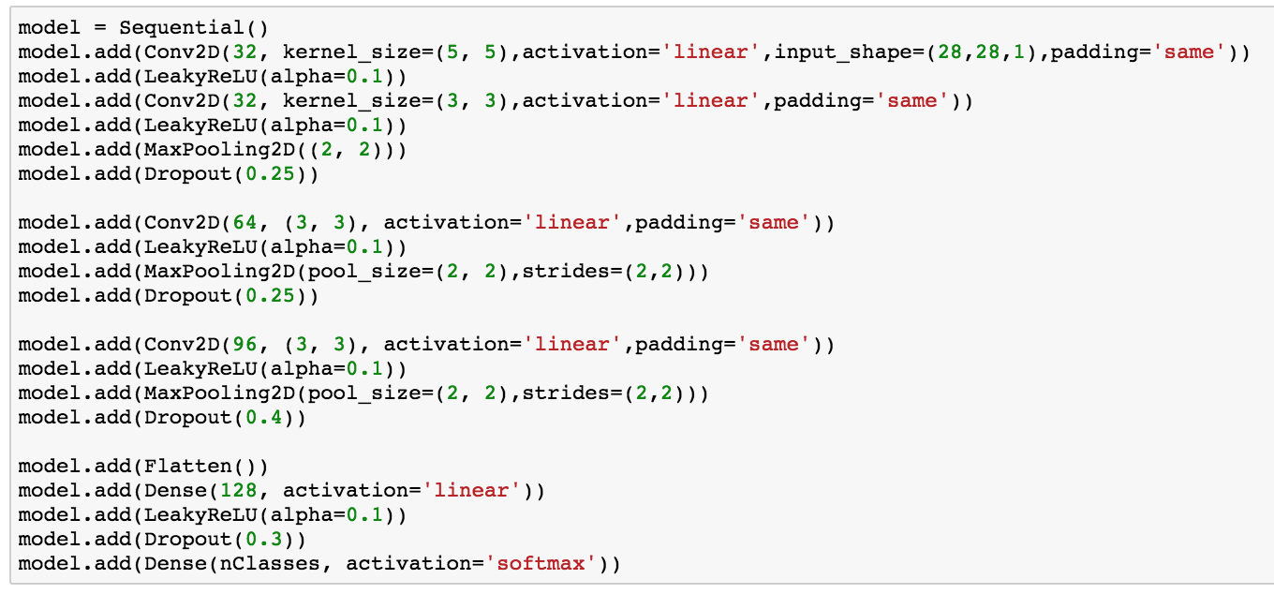
Model Explanation
Model Page
Model Explanation
Notebook Display

Slide 15
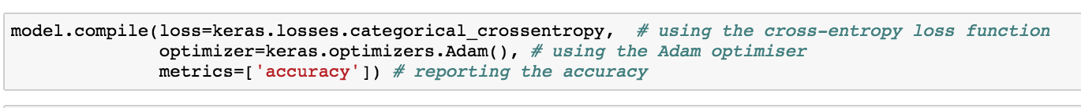
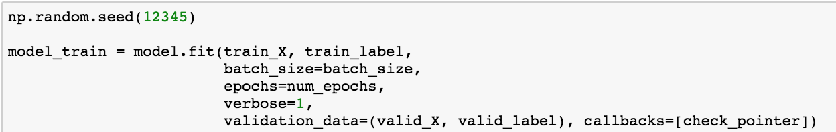
Training Model
Model Page
Compile
and
Train
1.Compile
After setting layers of the model, we would compile the model using the Adam optimizer, one of the most popular optimization algorithms. In addition, we specify the loss type as categorical cross entropy used for multi-class classification and specify the metrics as accuracy which enable us to analyze while training model.
2.Train
Because the model will be trained in 35 epochs, there may be overfitting in the final model. To avoid the overfitting, the check pointer will be applied. It can save the best model in training based on the accuracy of validate data into external document which can be loaded next time and used to predict the test data.

Slide 16
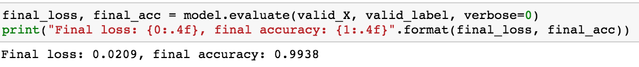
Model Evaluation
Model Results 1
99.38
%
We used validation set to evaluate our model since test.csv did not provide the label and it can not test accuracy of the model. Later, we would conclude the ultimate accuracy score rated by Kaggle competition. As figure 9 showed, our model finally achieved a 99.38% accuracy with validation and only 0.0209 final loss. Although it is not our ultimate accuracy with test, it still indicates our model performs well.
Predicting Power

Slide 17
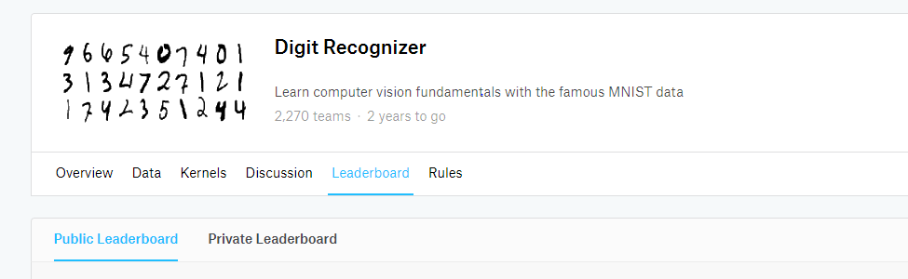
Model Evaluation
Model Results 2
99.457
%
According to the findings above, we found out that using CNN model (In → Conv2D→ LeakyRelu→ [ Conv2D→ LeakyRelu → MaxPool2D → Dropout]*3 → Flatten → Dense → Dropout → Out) to recognize the patterns, we will get 99.457% of correct classification rate.
Test on Kaggle

Slide 18

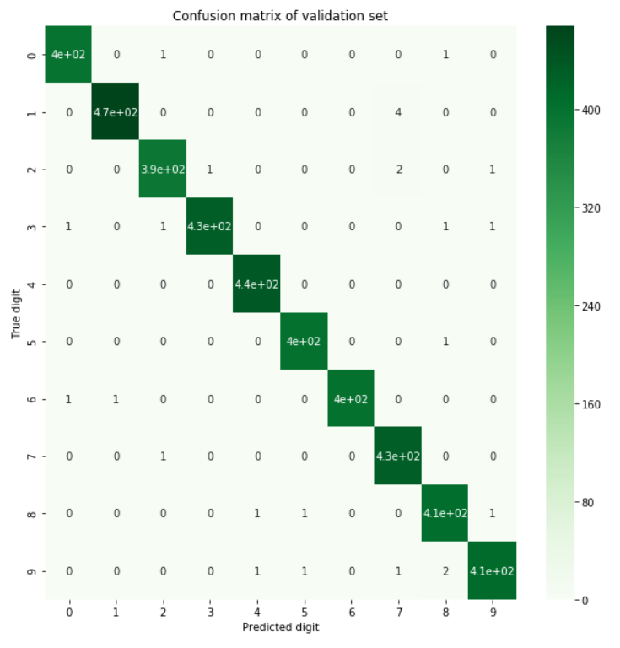
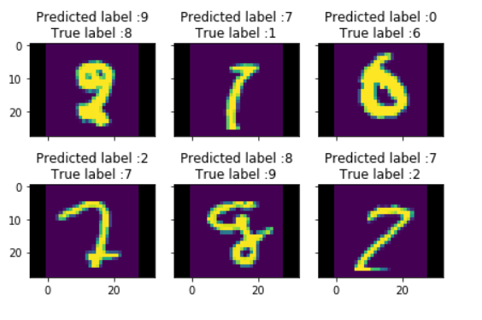
Model Evaluation
Model Results 3
Confusion matrix
Results
Confusion Matrix
+
According to the confusion matrix, our model predicted the numbers mostly correct with a small number of misclassification. It misclassified number “1” as “7” and “2” as “7”. It is reasonable because when the handwriting is smooth, human eyes may mis-recognize those numbers and don't even mention the computers.
Misclassification in Validation
+

Slide 19
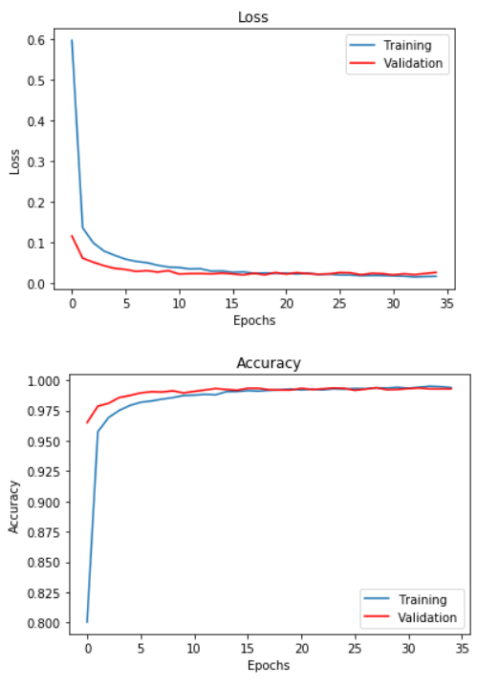
Model Evaluation
Model Results 5
Validation Loss and Accuracy Plot
As shown in figure to the left, we can easily find that the best epochs is about that achieved the lowest loss and highest accuracy for both the training and validation set. In addition, we observed that for certain range of epochs, training set outperformed validation set and validation set also outperformed training set for some epochs. It indicates our model is neither overfitting nor underfitting.

Slide 20
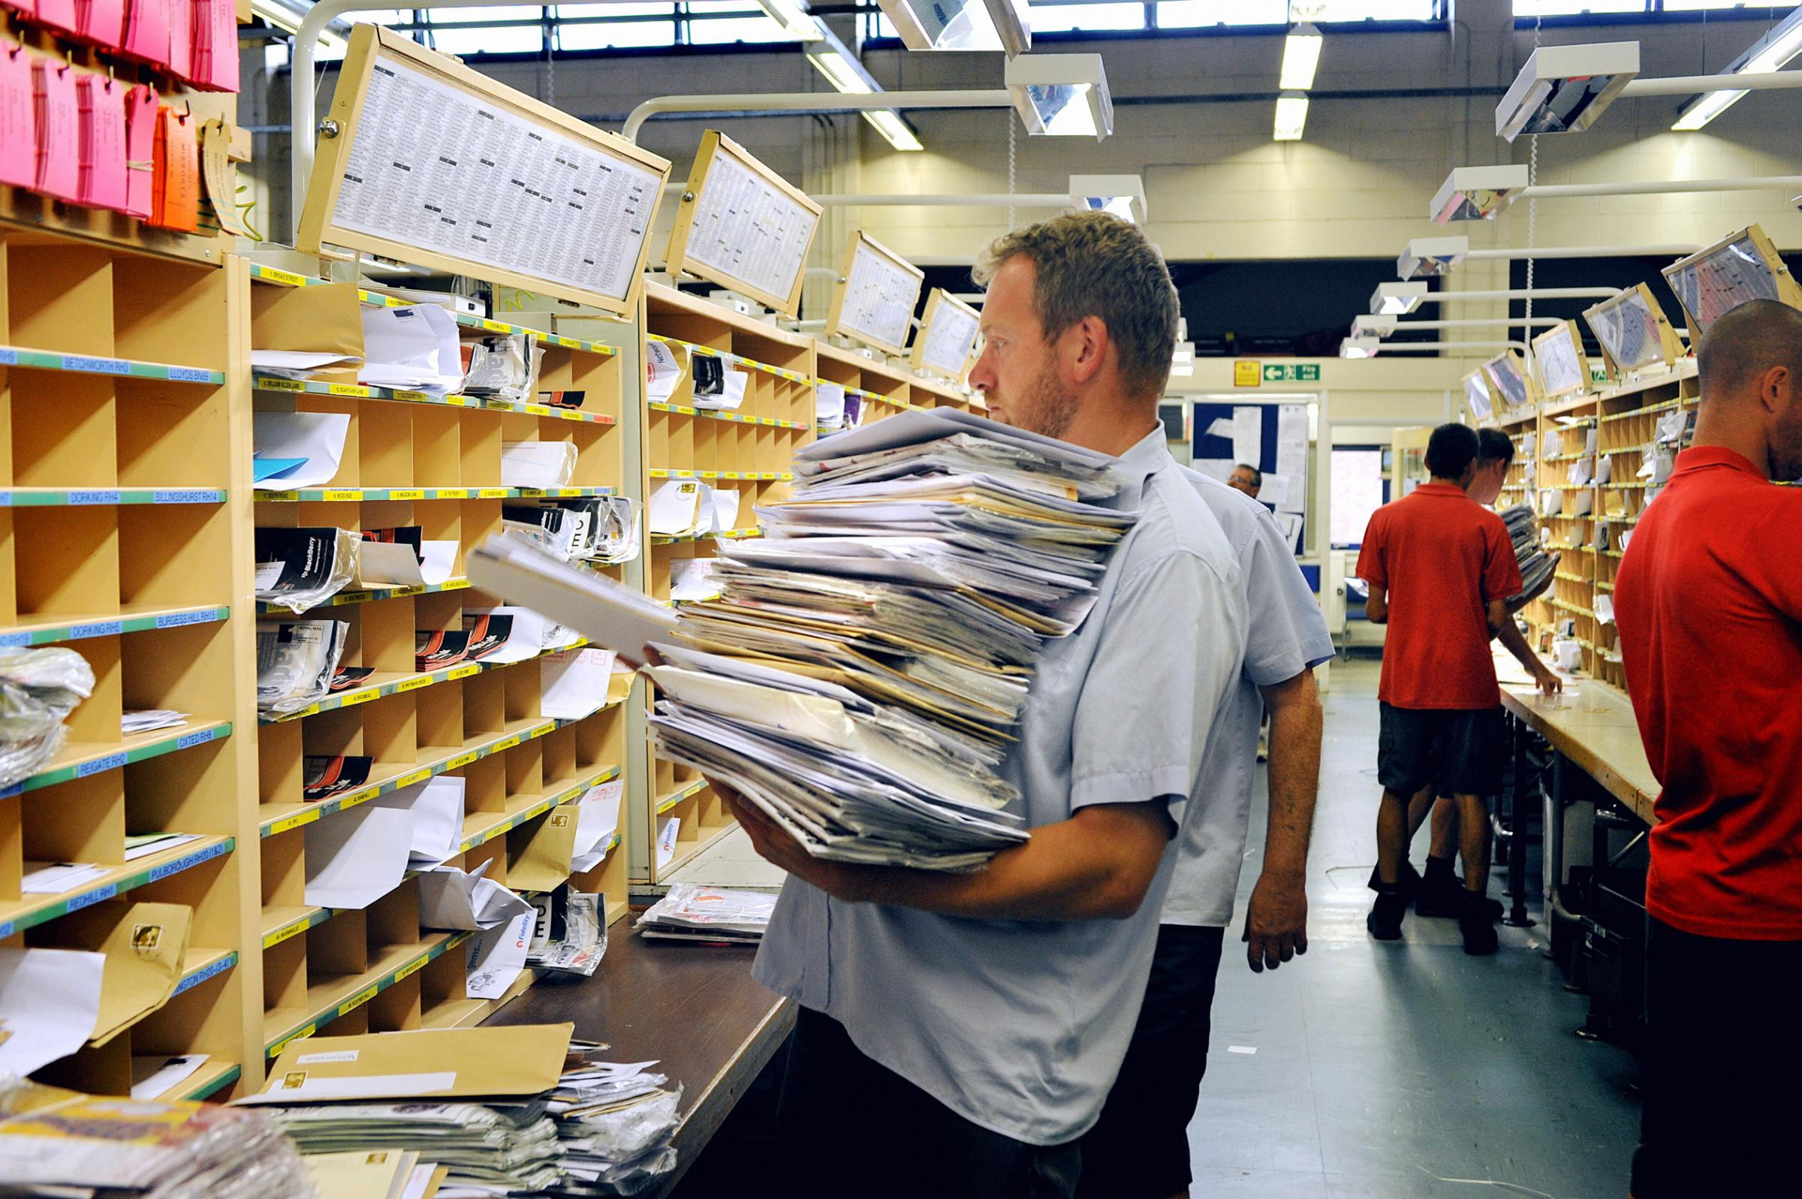
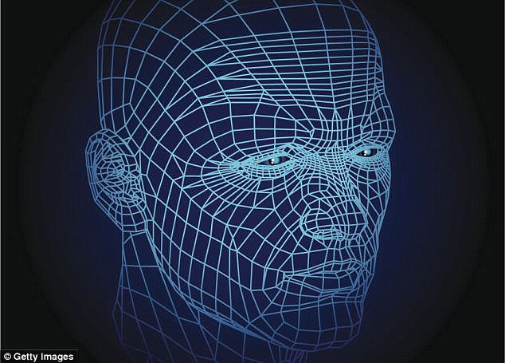
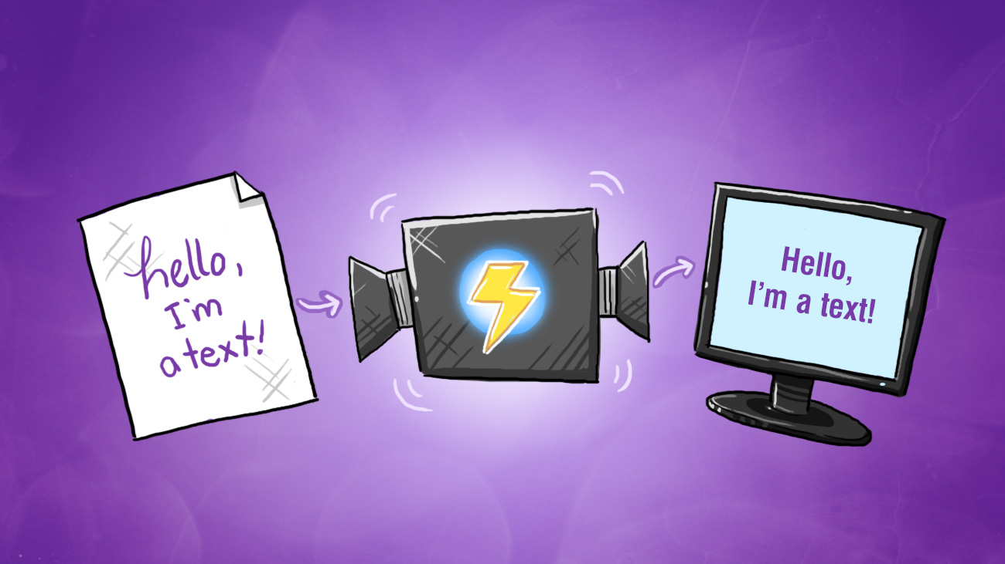

Application
Home Page
Further Application
Sorting centers are asking for more accurate and more efficient mail sorting system
Photo capture translation
Handwritten Input purpose Application
Great recognition system for human information storage
2018FallDataMiningGroup7@gwu.edu

Slide 21

THANK YOU
Data Mining Group 7 Presentation
2018.04.19

